Slide 1
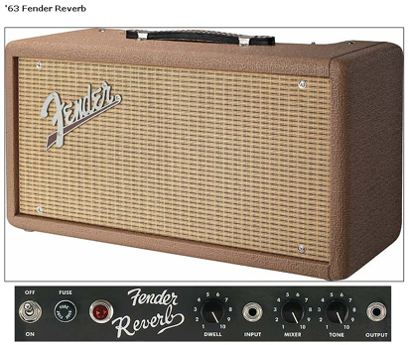
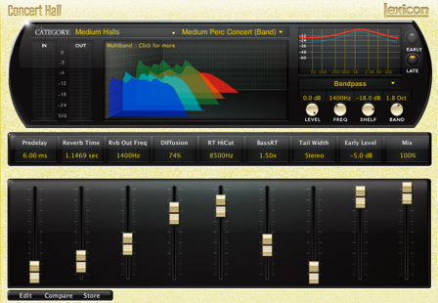
Reverb

Slide 2
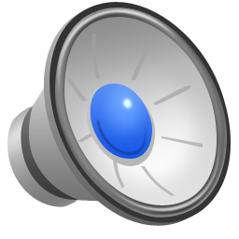
What is reverberation?
Series of delayed and attenuated sound waves
Result of many reflections within a space
Multiple paths from a source to our ears
Direct path
Strongest and first
Reflected paths, bouncing off walls or ceiling
Weaker and arrive later
Creates spaciousness of a room
Reverb is omnipresent so we often ignore it
listen after short, impulsive sounds, while sound still bouncing around
clap your hands
Sound without processing (dry sound), followed by same sound with reverb added Listen just after accented notes

Slide 3
Reverb, echo and delay
not just series of echoes
Echo: distinct, delayed version of sound
Delay more than 0.1-0.2 seconds
Reverb: many closely-spaced copies of a sound
Do not perceive reflections as echoes
But overall effect is highly audible
Delay with feedback does not produce reverb
Delay: reflections with fixed time interval
Reverb: rate of reflections changes over time
Greater spacing of initial reflections, closer spacing later

Slide 4
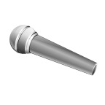
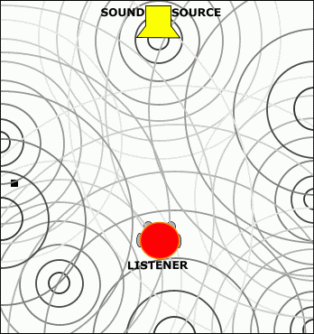
Early & late reflections
Early reflections
Short period after direct sound
Well-defined and directional reflections
Directly related to;
size and shape of room
position of source and listener
Late reflections
Diffuse reverberation
Density greatly increases
More randomly spaced
Follows early reflections
Difficult to relate to physical characteristics of room
Major factor establishing room size
decays exponentially in good concert halls
Microphone
Source

Slide 5
Impulse response
Early
Reflections
Late
Reflections
Time
Series of scaled delta functions
Each vertical line marks when sound heard again
represents delayed, attenuated copy of sound
Height of lines represents how loud sound is at that time
What would simple feedback delay look like?

Slide 6
Correlation
For stereo reverb, correlation of signals reaching each ear gives sense of spaciousness
low ceiling
First reflections from ceiling (not walls)
reach both ears at the same time
Coherent reflections give sense of small space
high ceiling
First reflections from walls
Walls are different distances away
path different for each ear
Sound arriving at each ear is different (incoherent)
Not strongly correlated

Slide 7
Reverberation time
Characterises reverberation in room
Important overall metric of reverb
Reverberation time (RT₆₀)
Time for sound pressure level to decay to 10⁻⁶ (60 dB) original value
10⁻³ original amplitude
Long reverberation times
→ sound energy stays in room longer before being absorbed
Associated with room size
Concert hall reverberation time~ 1.5 - 2 seconds

Slide 8
Reverberation time: factors
Room surfaces
How much energy lost on each reflection
Reflective materials increase reverberation time
concrete, tiles, ...
Absorptive materials reduce reverberation time
curtains, carpet, people, ...
Absorptivity varies with frequency
Room size
Larger rooms have longer reverberation times
Longer distance for waves to travel between reflections
Air in the room
Air attenuates travelling sound waves, reducing reverb time
Attenuation varies with humidity and temperature
High frequencies affected most
Many reverb units thus include lowpass filters

Slide 9
Sabine equation
Sabine equation can estimate reverberation time in a room:
V = volume of room (m³)
c = speed of sound in air (343 m/s)
S = total surface area of room (m²)
= average absorption coefficient for room
Where α_{i} are individual absorption coefficients for each surface Si

Slide 10
Absorption and reverberation time
Example coefficients for various room surfaces:
Reverberation time differs by frequency band
1000Hz band
2.6 seconds for an empty room
0.93 seconds for room with carpet
Frequency (Hz) | 125 | 250 | 500 | 1000 | 2000 | 4000
Concrete block, painted | 0.10 | 0.05 | 0.06 | 0.07 | 0.09 | 0.08
Concrete floor | 0.01 | 0.01 | 0.015 | 0.02 | 0.02 | 0.02
Carpet on concrete | 0.02 | 0.06 | 0.04 | 0.37 | 0.60 | 0.65
Carpet on foam rubber | 0.08 | 0.24 | 0.57 | 0.69 | 0.71 | 0.73

Slide 11
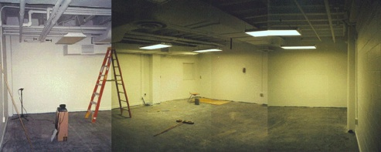
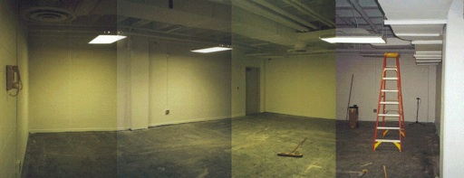
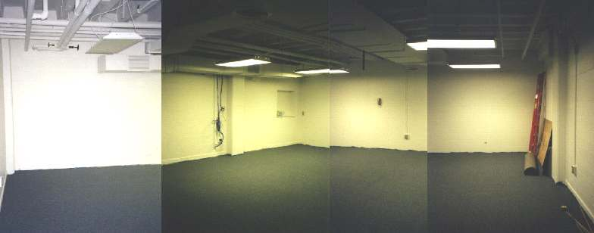

Absorption and reverberation time
Composite photographs of an empty room:
Composite photograph of same room with carpet:
Hand Clap (room empty)
Hand Clap (with carpet)
Speech (room empty)
Speech (with carpet)

Slide 12
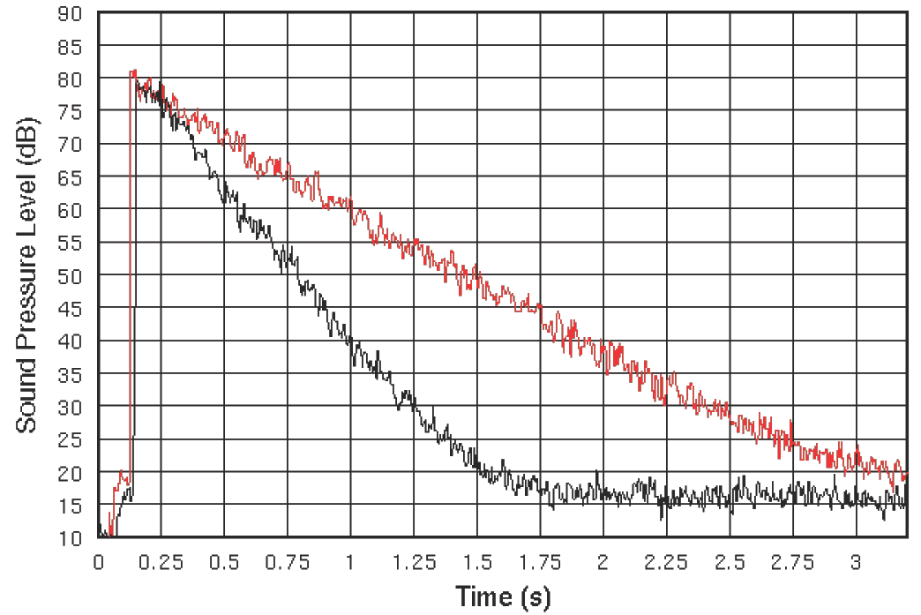
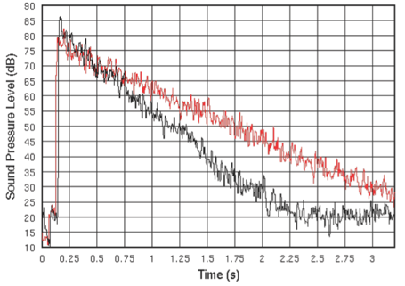
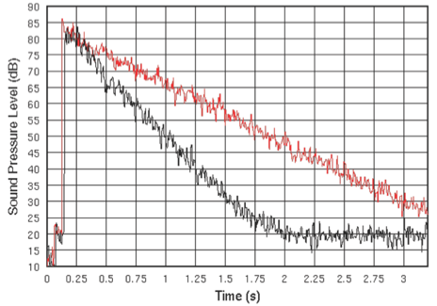
Measured reverberation time
Hand clap samples
Red shows empty room
Black shows carpeted room
Based on 1000Hz plot
RT₆₀= 3.3s empty, 1.6s carpet
Measured > Sabine equation
Cavities in ceiling trap sound
Sabine assumes uniform distribution of absorption
2000Hz
500Hz
1000Hz

Slide 13
Direct and reverberant sound fields
Direct field: source sound louder than reflections
Reverberant field: SPL from reflected sounds greater than direct sound
Depends on distance from source
Critical distance
point where direct and reflected sounds are equal in volume
Reverberant fields are highly important
Most listening situations are reverberant fields
Reverb keeps sound energy localised in a room
raising overall SPL and distributing sound
Outdoors, reflective surfaces missing and energy lost

Slide 14
Reverberant fields in music
Reverberant field distributes sound more evenly in space
Helps hear all instruments in an ensemble
Some instruments are farther away than others from audience
Many instruments are highly directional in their radiation
In direct field, violin sounds different as you move around
Less true in a reverberant field which spreads energy around
Large reverberation time makes it difficult to understand speech or follow musical lines
The ideal direct field: anechoic chamber
Room designed to have no reflections

Slide 15
Why use reverb?
Why add artificial reverb to recorded sound?
Dry signals (e.g. close mic) sound unnatural
Compensate for non-reverberant listening environment
Headphones have no natural reverb
Car or small room might not have sufficient reverberance to recreate sound of orchestra in concert hall
Can add natural reverb by recording in large room
Distant microphones capture ambience as well as direct signal
Impractical in many situations
→ Add reverb synthetically

Slide 16
Signal processing methods
Algorithmic reverb
Early algorithms used two types of IIR filters
Comb filter: regular notches in frequency response
Allpass filter: change phase but pass frequencies equally
Goal to mimic reflections within a room, especially gradual decay of later reflections
Convolutional reverb
Convolve a signal with a known impulse response
Many techniques using circular buffers and delay lines
Hybrid methods

Slide 17
Schroeder’s reverberator
Early reverb work by Manfred Schroeder (1960s)
One Schroeder design:
4 comb filters
2 allpass filters
Basic simulation, but lacks important features
Increasing arrival of later reflections
Not as effective as modern algorithms

Slide 18
Schroeder’s reverberator
A Schroeder allpass section. Typical value for g is 0.7
Schroeder’s comb filter
(a)
g
(b)
g
x[n]
+
y[n]
x[n]
+
y[n]
d
d
1-g²
+
-g

Slide 19
Moorer’s reverberator
J. A. Moorer. About this reverberation business. Computer Music Journal 3(2):13-18, 1979
FIR filter simulates early room reflections
Also consider as a tapped delay line (19 taps)
In cascade with a bank of comb filters
FIR filter coefficients from Moorer’s article
Based on geometric simulation of Boston Symphony Hall
Comb filters have unusual gain parameters
Include a lowpass filter in the feedback loop
Simulates absorption of high frequencies by the air
All-pass filter with group delay 6ms at DC & gain 0.7

Slide 20
Moorer’s reverberator
FIR filter to simulate early reflections
X(z)
Early reflections
z^{-d1}
z^{-d2}
z^{-d3}
z^{-dn}
…
c₁
c₂
c₃
c_{n}
+
LP Comb
Y(z)
+
LP Comb
Parallel comb filters with lowpass filtering to simulate late reflections
LP Comb
+
Allpass
z^{-d}
LP Comb
LP Comb
LP Comb
Late reflections

Slide 21
Moorer’s reverberator
6 parallel comb filters with different delay lengths
Simulate modes of a room
Sound reflecting between parallel walls
Allpass filter to increase the reflection density
Avoid flutter echoes (rapid echo of even rate)
Lowpass filters in feedback loops
Alter reverberation time as a function of frequency
Different in each comb filter because their coefficients depend on delay line length
Last delay block
Used to delay late reflections compared to early ones

Slide 22
Flutter Echoes
Output of single comb filter has distinct periodicity
distances between adjacent echoes decided by single delay parameter
Flutter echo - rapid multiple echo of even rate
Moorer’s Reverberator
To avoid periodicity, several comb filters with co-prime delays in paralleled

Slide 23
Examples
Concert hall simulation, RT₆₀ = 3.0s
Concert hall simulation, RT₆₀ = 0.4s
1
0.8
Impulse Response for Moorer’s Reverberator,
RT₆₀=0.4s
0.6
0.4
0.2
Amplitude
0
-0.2
-0.4
-0.6
0
0.05
Time (s)
0.1
0.15
Some clicking, or something squishy can be heard during the word sitting
Notes:
Some clicking, or something sounds decidedly “squishy” can be heard during the word “sitting”.
Examples:
Concert hall simulation, RT60 = 3.0s
Concert hall simulation, RT60 = 0.4s
The figure below shows the impulse response of Moorer’s reverberator. Note the discrete early reflection times in the first 50 ms, which are followed by the comb filter activity.

Slide 24
Modelling room reverberation
Algorithms can model specific room properties
Ray tracing techniques (follow paths of sound waves)
Inputs include
Geometry of room
Sound source location
Listener location
Filters used
Finite impulse response (FIR) filter for early reflections
Infinite impulse respond (IIR) filters for later, diffuse reverberation
Low pass filters for modelling air absorption
Can get complicated very quickly

Slide 25

Convolution Reverb
Reverb completely characterised by impulse response
It is a linear, time-invariant (LTI) effect
Suppose we have impulse response of a room
Record impulse (like popping balloon) with microphone in one location, sound source in another location
Apply reverb by convolving signal with recorded impulse response
Makes it sound as if it is in the space

Slide 26
Convolution reverb
Naive convolution is very computationally expensive
Real impulses can be 3+ seconds long
At 44.1kHz, 3 seconds = 132300 samples
Like applying a 132300-coefficient FIR filter!
Can’t be done in real time. So what do we do?
Implement convolution as multiplication in frequency domain
Break the signal into blocks; take FFT of each block
Blocks overlap; know as overlap-add process
Same as phase vocoder
Problem: how long of an FFT to use?
As long as the impulse?
Latency will be at least 3 seconds. Not usable!
Also, not very efficient
Several possible solutions involving groups of smaller FFTs

Slide 27
One block convolution
S_{kN:(k+1)N-1} zeros
FFT
IFFT
X
r
2N
FFT
h zeros
N N

Slide 28
Partitioned convolution for real-time artificial reverberation.
s
s_{0:N-1}
s_{N:2N-1}
s_{2N:3N-1}
s_{3N:4N-1}
…
h
h
h
h
…
Convolve impulse response & current block
{
…
s_{N:2N-1}*h
s_{3N:4N-1}*h
…
s_{0:N-1}*h
s_{2N:3N-1}*h
…
Sum end of previous convolution & beginning of current convolution
{
…
r
…

Slide 29
Common parameters
Parameters vary by unit, type of implementation
Common parameter: reverb decay
How quickly the reverberant sound fades
Exact measurement varies by manufacturer
Usually measured in milliseconds
Like reverberation time for a room
Predelay = how long before first reflections sound
Some units allow control of both early and late reflections
Predelay 2
Predelay 1
Time

Slide 30
Gated reverb
Truncate impulse response of reverb unit
Like changing IIR filters to FIR
Alternately, only allow a finite number of reflections
Commonly used on drums
Gate time
Amount of time sound can reverberate
Sometimes an abrupt silence
Some units allow a gradual decay
Alternatively, gate threshold
Similar to noise gate threshold
Stop reverb when it falls below a certain level
Gate Time
Time

Slide 31
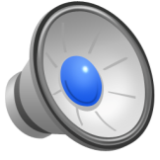
Reverse reverb
Reverse reverb simulates reflections where sound gets louder over time, then cuts off
Opposite of natural effect where reflections become quieter
Reverse time or gate time = how long sound builds up
Similar to gated reverb reversed in time
May sound like slapback delay since it ends suddenly
Sound example: dry, 50ms reverse time, then 150ms
Reverse Time
Time

Slide 32
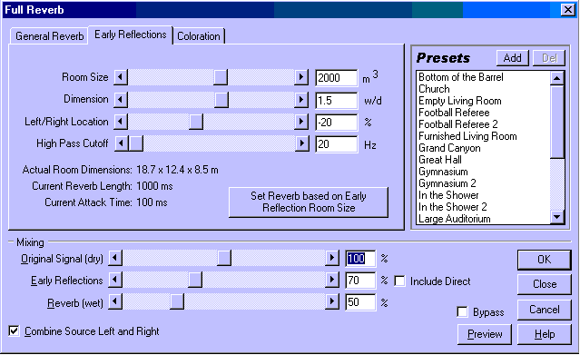
Software I
CoolEdit Pro
Standard Reverb settings

Slide 33
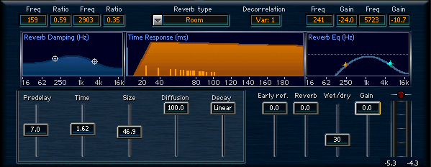
Software II
Renaissance Reverberator by Waves
Highshelf and Lowshelf EQs for
Damping(left)
final output(right)
upper middle display depicts
Early Reflections placement and level
Reverb portion start and fading
Above this display is Reverb Type selector
changes placement & level of Early Reflections
Size slider has influence on Early Reflections as well

Slide 34
The Reverb Class in JUCE
Audio development environments often have classes, nodes… that
Are trivial to use with default settings
Lots of optional parameters
Lots going on under the hood
The Reverb class
Performs reverb effect on a stream of audio data.
Simple stereo or mono reverb
Based on Freeverb
Similar to Moorer's reverberator
Start with basic HelloWorld plugin →

Slide 35
Define and initialise
Additional parameters on interface
Add private parameters to pluginProcessor.h
Add audio parameters & adjust their ranges in pluginProcessor.cpp
Set sample rate for reverb in PrepareToPlay
The only initialisation this reverb needs
AudioParameterFloat* roomSize,* damping,* wetLevel,* dryLevel,* width;
AudioParameterBool* freezeMode;
Reverb reverb;
addParameter(roomSize= new AudioParameterFloat("roomSize","Room size",0.0f,1.0f,0.5f));
addParameter(damping= new AudioParameterFloat("damping","Damping",0.0f,1.0f,0.5f));
addParameter(wetLevel= new AudioParameterFloat("wetLevel","Wet level",0.0f,1.0f,0.33f));
addParameter(dryLevel= new AudioParameterFloat("dryLevel","Dry level",0.0f,1.0f,0.4f));
addParameter(width= new AudioParameterFloat("width", "Width",0.0f,1.0f,1.0f));
addParameter(freezeMode= new AudioParameterBool("freezeMode","Freeze mode",0));
void ReverbAudioProcessor::prepareToPlay (double sampleRate, int samplesPerBlock) {
reverb.setSampleRate(sampleRate);
}
Notes:
MidiKeyboardComponent needs a MidiKeyboardState and the orientation as arguments.

Slide 36
Prepare
Set sample rate for the reverb in PrepareToPlay
It is the only initialisation this reverb needs
Set reverb parameters from UI in processBlock
void ReverbAudioProcessor::prepareToPlay (double sampleRate, int samplesPerBlock)
{
reverb.setSampleRate(sampleRate);
}
Holds parameters for reverb object
Reverb::Parameters params = reverb.getParameters();
params.roomSize = roomSize->get();
params.damping = damping->get();
params.wetLevel = wetLevel->get();
params.dryLevel = dryLevel->get();
params.width = width->get();
params.freezeMode = freezeMode->get();
reverb.setParameters(params);
Notes:
MidiKeyboardComponent needs a MidiKeyboardState and the orientation as arguments.

